Slide 1









AMD-III-36 - EMPLOYING TF-IDF AND WORD2VEC EMBEDDINGS TO IDENTIFY MULTI-CLASS TOXICITY THROUGH MACHINE AND DEEP LEARNING APPROACHES
Anu Likitha Immadisetty
Department of CSE, SRM University - AP
22nd OITS International Conference on Information Technology
(OCIT-2024)
December 13th, 2024

Slide 2
01
PROBLEM
STATEMENT
05
PROBLEM IDENTIFICATION
TABLE OF CONTENT
02
06
METHODOLOGY
INTRODUCTION
03
07
RESULTS &
DISCUSSION
BACKGROUND
04
LITERATURE SURVEY
08
CONCLUSION &
REFERENCES
13/12/2024
2

Slide 3
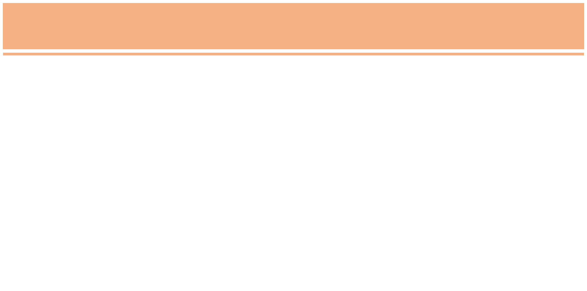

Problem Statement
Toxicity on online platforms affects millions of users globally, with many unaware of the impact their interactions may have on others.
Studies show that 66% of harassment incidents occur on social media, with 21% of targets abandoning platforms altogether.
Early detection of harmful content is essential to prevent serious psychological and social repercussions.
This study leverages advanced machine learning models to develop accurate tools for identifying and mitigating online toxicity, fostering safer and more respectful digital environments.
13/12/2024
3

Slide 4

Introduction
a) Toxicity Prevalence and Impact: Toxicity in online platforms has become a critical concern, affecting millions of users worldwide. It contributes to severe consequences.
b) Machine Learning for Toxicity Detection: Advanced ML techniques, including Logistic Regression, Naive Bayes, Adaboost, Gradient Boosting and Deep Learning Models like LSTMs and BI-LSTM hold immense promise for detecting and mitigating toxic behavior.
13/12/2024
4

Slide 5




Background
The rise of online platforms has revolutionized communication, enabling global connectivity and the sharing of ideas.
However, this digital transformation has also led to the proliferation of toxic content, including hate speech, cyberbullying, and offensive remarks.
Toxicity on the internet has become a significant concern, as it hampers healthy discussions, harms individuals, and can drive users away from platforms altogether.
The need for effective automated detection and moderation systems to identify and mitigate toxic content has never been more critical in maintaining a safe and respectful online environment.
13/12/2024
3
5

Slide 6
Literature Survey
Deep Learning Models (LSTM, BiLSTM)
LSTM and BiLSTM models successfully handled sequential data, improving toxicity classification.
BiLSTM, in particular, captured bidirectional dependencies in text.
Early Approaches to Toxicity Detection
Initial studies focused on manual classification of toxic content in online platforms which
Ensemble Methods (AdaBoost, Gradient Boosting)
Ensemble methods showed promise by combining multiple classifiers for better results.
AdaBoost and Gradient Boosting outperformed individual models in some cases.
Machine Learning for Text Classification
Techniques like Naive Bayes, SVM, and Decision Trees were applied to classify toxic vs non-toxic content..
Word Embeddings for Improved Accuracy
Embeddings like Word2Vec and GloVe provided richer representations of words, enhancing model performance.
Combined with deep learning, these embeddings helped capture context more effectively.
Recent Advancements and Future Directions
Attention mechanisms integrated with LSTM models showed potential for better toxicity detection.
Transfer learning approaches like BERT and GPT are being explored for high accuracy and scalability.
13/12/2024
6

Slide 7
TOXIC
OBSCENE
Category
Category
Obscenity refers to offensive, vulgar, or indecent content, often involving explicit language, sexual references, or graphic material that is inappropriate for general audiences.
Example: "That’s a disgusting joke, keep it to yourself"
Toxicity refers to harmful or offensive behavior that can upset or harm others. It includes insults, bullying, hate speech, and any negative content that creates a hostile environment.
Example: "You're an idiot, no one likes you"
INSULT
NON TOXIC
Category
Category
An insult is a disrespectful or hurtful remark aimed at offending or belittling someone, often targeting their appearance, intelligence, or character.
Example: "You're so dumb, you'll never get anything right"
Non-toxic refers to content that is respectful, kind, and free from harmful or offensive language. It promotes positive communication, supportive environment.
Example: "Great job on your project! Keep up the good work!"
13/12/2024
7

Slide 8


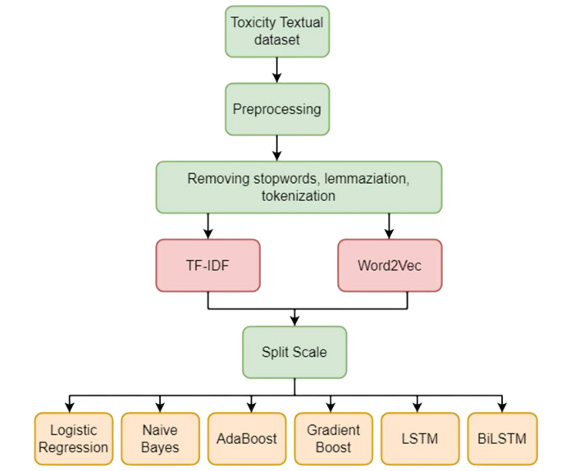
Methodology
13/12/2024
9

Slide 9





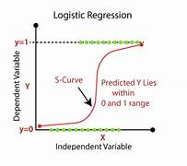
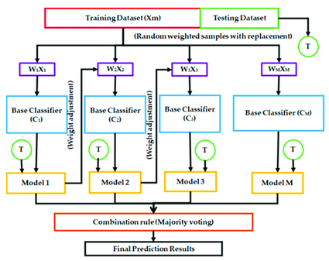
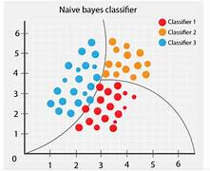
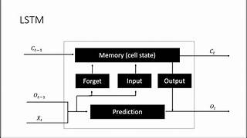
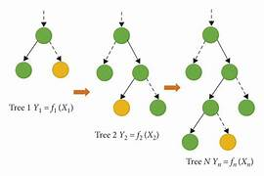
LOGISTIC REGRESSION
ADABOOST
LSTM & BI-LSTM
NAIVE BAYES
An ensemble model that
combines multiple weak classifiers
to create a strong classifier,
excelling in identifying subtle
patterns in textual data for
accurate toxicity detection.
GRADIENT BOOSTING
RNN that capture long-term dependencies in sequential text data.
While LSTM focuses on learning from past context, Bi-LSTM processes text in both forward and backward directions, improving toxicity detection by capturing a more comprehensive understanding of context in online conversations.
A binary classification model
that predicts online toxicity by
calculating the probability of
toxic behavior using a logistic
function, effective with
diverse textual data.
A probabilistic model that
applies Bayes' theorem with
independence assumptions,
efficiently classifying toxic
content by leveraging
word frequency and patterns.
An ensemble technique that
builds strong classifiers by
sequentially correcting errors
of weak models, highly effective
in detecting complex patterns
of toxicity in text data.
13/12/2024
10

Slide 10
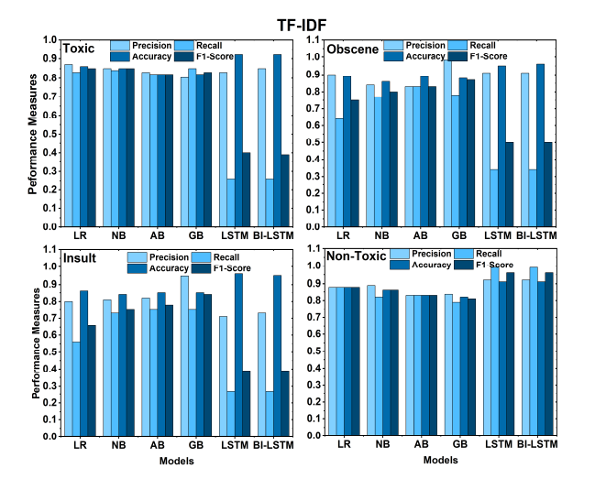
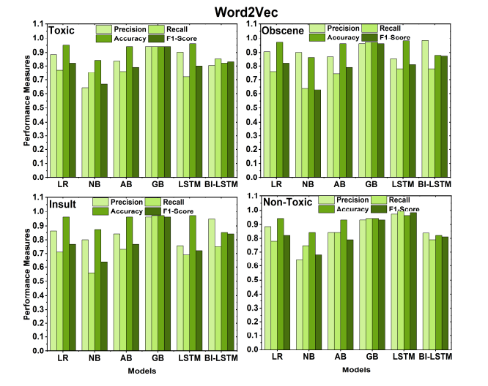
Results
13/12/2024
11

Slide 11
Results - Discussion
1) Assessment with TF-IDF Vectorization
LSTM & BiLSTM Performance: Both models achieved a 93% accuracy due to their design to process sequential data. They leverage the unique importance of words and context, enabling effective classification.
Gradient Boosting Performance: Despite being a powerful model for complex patterns, it performed the least due to its inability to account for the sequential nature of text data.
2) Assessment with Word2Vec Vectorization
LSTM Performance: The LSTM model achieved 92% accuracy, effectively using Word2Vec's dense word embeddings. It captures contextual and semantic meanings, making it ideal for understanding text patterns.
BiLSTM Performance: BiLSTM achieved 84% accuracy, lower than LSTM, possibly due to challenges in training with more parameters. While BiLSTM captures bidirectional context, it may not have been as optimized as LSTM for this task.
13/12/2024
12

Slide 12
Conclusion
Key Findings: Word2Vec embeddings combined with LSTM achieved the highest accuracy, while logistic regression performed exceptionally well, surpassing ensemble methods.
Feature Engineering: The results highlight the significance of careful model selection and feature engineering, especially when using word embeddings like Word2Vec.
Promising Results: Multi-label classification with a large dataset and integrated methods showed strong potential for accurate text classification.
13/12/2024
13

Slide 13
References
[1]. Salminen, J., Almerekhi, H., Milenković, M., Jung, S. G., An, J., Kwak, H., & Jansen, B. (2018, June). Anatomy of online hate: developing a taxonomy and machine learning models for identifying and classifying hate in online news media. In Proceedings of the International AAAI Conference on Web and Social Media (Vol. 12, No. 1).
[2]. Almerekhi, H., Kwak, H., Salminen, J., & Jansen, B. J. (2020, April). Are these comments triggering? predicting triggers of toxicity in online discussions. In Proceedings of the web conference 2020 (pp. 3033-3040).
[3]. Almerekhi, H., Kwak, H., Jansen, B. J., & Salminen, J. (2019, September). Detecting toxicity triggers in online discussions. In Proceedings of the 30th ACM conference on hypertext and social media (pp. 291-292). Del Bosque, L. P., & Garza, S. E. (2016). Prediction of aggressive comments in social media: an exploratory study. IEEE Latin America Transactions, 14(7), 3474-3480.
[4]. Sperandei, S. (2014). Understanding logistic regression analysis. Biochemia medica, 24(1), 12-18.
[5]. Crawford, K., & Gillespie, T. (2016). What is a flag for? Social media reporting tools and the vocabulary of complaint. New Media & Society, 18, 410 - 428.
[6]. Cheng, J., Bernstein, M., Danescu-Niculescu-Mizil, C., & Leskovec, J. (2017). Anyone Can Become a Troll: Causes of Trolling Behavior in Online Discussions. CSCW : proceedings of the Conference on Computer-Supported Cooperative Work. Conference on Computer-Supported Cooperative Work, 2017, 1217–1230. https://doi.org/10.1145/2998181.2998213.
[7]. Yin, D., Xue, Z., Hong, L., Davison, B.D., & Edwards, L. (2009). Detection of Harassment on Web 2.0.
[8]. Stevens, F., Nurse, J. R., & Arief, B. (2021). Cyber stalking, cyber harassment, and adult mental health: A systematic review. Cyberpsychology, Behavior, and Social Networking, 24(6), 367- 376
[9]. Georgakopoulos, S. V., Tasoulis, S. K., Vrahatis, A. G., & Plagianakos, V. P. (2018, July). Convolutional neural networks for toxic comment classification. In Proceedings of the 10th hellenic conference on artificial intelligence (pp. 1-6).
[10]. Watanabe, H., Bouazizi, M., & Ohtsuki, T. (2018). Hate speech on twitter: A pragmatic approach to collect hateful and offensive expressions and perform hate speech detection. IEEE access, 6, 13825-13835.
13/12/2024
14

Slide 14





Thank You
10

